Slide 1


Big Data Infrastructure
CS 489/698 Big Data Infrastructure (Winter 2017)
Week 12: Real-Time Data Analytics (1/2)
March 28, 2017
Jimmy Lin
David R. Cheriton School of Computer Science
University of Waterloo
These slides are available at http://lintool.github.io/bigdata-2017w/
This work is licensed under a Creative Commons Attribution-Noncommercial-Share Alike 3.0 United States See http://creativecommons.org/licenses/by-nc-sa/3.0/us/ for details

Slide 2

users
Frontend
Backend
OLTP database
ETL (Extract, Transform, and Load)
Data Warehouse
My data is a
day old…
BI tools
Meh.
analysts

Slide 3
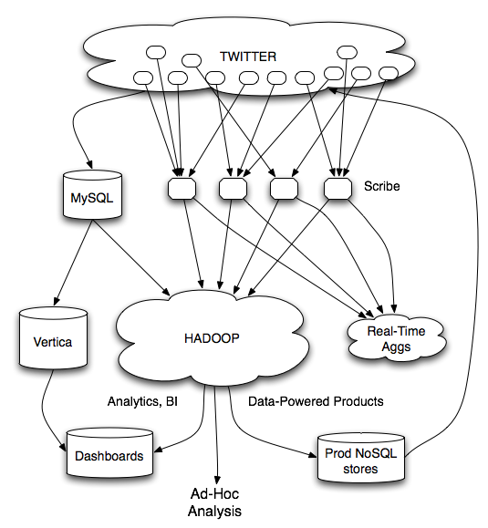
Twitter’s data warehousing architecture

Slide 4

Mishne et al. Fast Data in the Era of Big Data: Twitter's Real-Time Related Query Suggestion Architecture. SIGMOD 2013.

Slide 5
Case Studies: Steve Jobs passes away

Slide 6
Initial Implementation
Algorithm: Co-occurrences within query sessions
Implementation: Pig scripts over query logs on HDFS
Problem: Query suggestions were several hours old!
Why?
Log collection lag
Hadoop scheduling lag
Hadoop job latencies
We need real-time processing!
(stay tuned next time for actual solution)

Slide 7
real-time
vs.
online
vs.
streaming

Slide 8
What is a data stream?
Sequence of items:
Structured (e.g., tuples)
Ordered (implicitly or timestamped)
Arriving continuously at high volumes
Sometimes not possible to store entirely
Sometimes not possible to even examine all items

Slide 9
Applications
Network traffic monitoring
Datacenter telemetry monitoring
Sensor networks monitoring
Credit card fraud detection
Stock market analysis
Online mining of click streams
Monitoring social media streams

Slide 10
What exactly do you do?
“Standard” relational operations:
Select
Project
Transform (i.e., apply custom UDF)
Group by
Join
Aggregations
What else do you need to make this “work”?

Slide 11
Issues of Semantics
Group by… aggregate
When do you stop grouping and start aggregating?
Joining a stream and a static source
Simple lookup
Joining two streams
How long do you wait for the join key in the other stream?
Joining two streams, group by and aggregation
When do you stop joining?
What’s the solution?

Slide 12
Windows
Windows restrict processing scope:
Windows based on ordering attributes (e.g., time)
Windows based on item (record) counts
Windows based on explicit markers (e.g., punctuations)

Slide 13
Windows on Ordering Attributes
Assumes the existence of an attribute that
defines the order of stream elements (e.g., time)
Let T be the window size in units of the ordering attribute
t₁
t₂
t₃
t₄
t₁'
t₂’
t₃’
t₄’
sliding window
t_{i}’ – t_{i} = T
t₁
t₂
t₃
tumbling window
t_{i+1} – t_{i} = T

Slide 14
Windows on Counts
Window of size N elements (sliding, tumbling) over the stream
t₁
t₂
t₁'
t₃
t₂’
t₃’
t₄’

Slide 15
Windows from “Punctuations”
Application-inserted “end-of-processing”
Example: stream of actions… “end of user session”
Properties
Advantage: application-controlled semantics
Disadvantage: unpredictable window size (too large or too small)

Slide 16
Streams Processing Challenges
Inherent challenges
Latency requirements
Space bounds
System challenges
Load balancing
Unreliable and out-of-order message delivery
Fault-tolerance
Consistency semantics (at most once, exactly once, at least once)

Slide 17
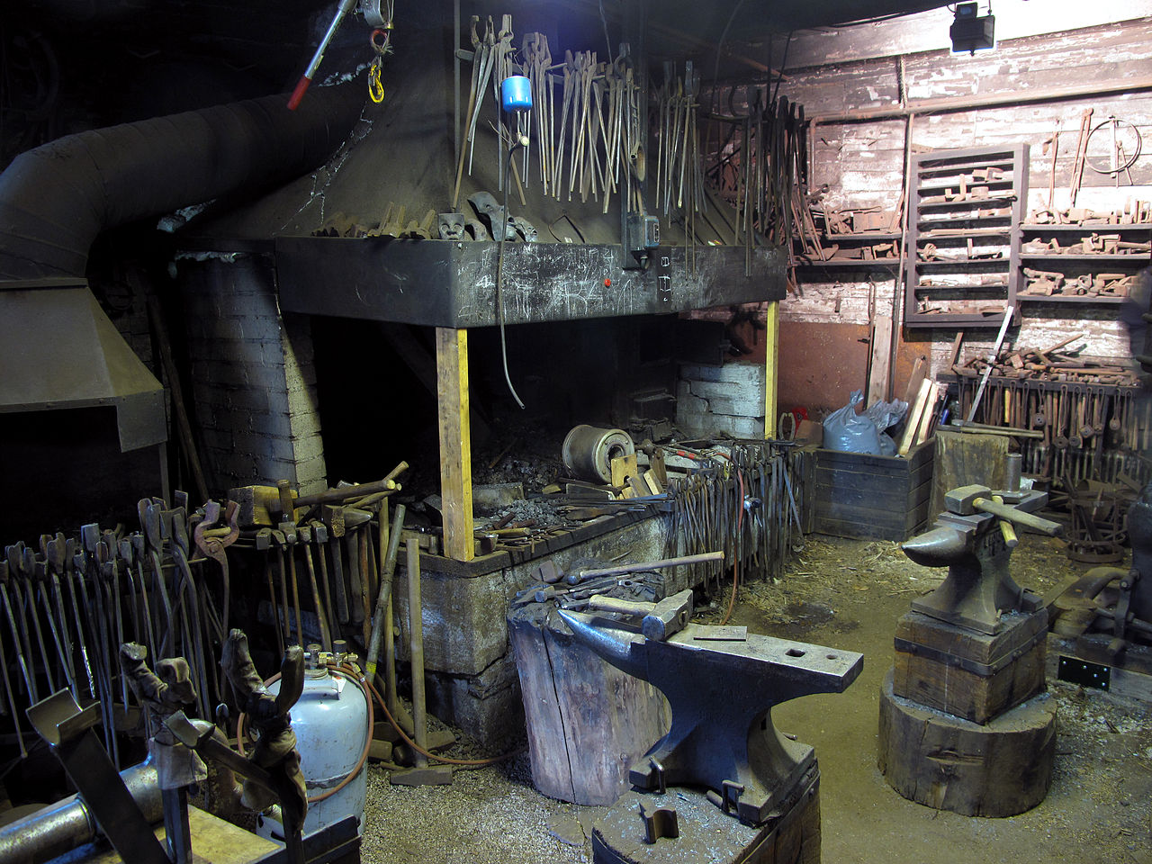
Common Techniques
Source: Wikipedia (Forge)

Slide 18
Streams Processing Challenges
Inherent challenges
Latency requirements
Space bounds
System challenges
Load balancing
Unreliable and out-of-order message delivery
Fault-tolerance
Consistency semantics (at most once, exactly once, at least once)

Slide 19
Space: The Final Frontier
Data streams are potentially infinite
Unbounded space!
How do we get around this?
Throw old data away
Accept some approximation
General techniques
Sampling
Hashing

Slide 20
Reservoir Sampling
Task: select s elements from a stream of size N with uniform probability
N can be very very large
We might not even know what N is! (infinite stream)
Solution: Reservoir sampling
Store first s elements
For the k-th element thereafter, keep with probability s/k (randomly discard an existing element)
Example: s = 10
Keep first 10 elements
11th element: keep with 10/11
12th element: keep with 10/12
…

Slide 21
Reservoir Sampling: How does it work?
Example: s = 10
Keep first 10 elements
11th element: keep with 10/11
If we decide to keep it: sampled uniformly by definition
probability existing item is discarded: 10/11 × 1/10 = 1/11
probability existing item survives: 10/11
General case: at the (k + 1)th element
Probability of selecting each item up until now is s/k
Probability existing item is discarded: s/(k+1) × 1/s = 1/(k + 1)
Probability existing item survives: k/(k + 1)
Probability each item survives to (k + 1)th round: (s/k) × k/(k + 1) = s/(k + 1)

Slide 22
Hashing for Three Common Tasks
Cardinality estimation
What’s the cardinality of set S?
How many unique visitors to this page?
HashSet
HLL counter
Set membership
Is x a member of set S?
Has this user seen this ad before?
HashSet
Bloom Filter
Frequency estimation
How many times have we observed x?
How many queries has this user issued?
HashMap
CMS

Slide 23
HyperLogLog Counter
Task: cardinality estimation of set
size() → number of unique elements in the set
Observation: hash each item and examine the hash code
On expectation, 1/2 of the hash codes will start with 1
On expectation, 1/4 of the hash codes will start with 01
On expectation, 1/8 of the hash codes will start with 001
On expectation, 1/16 of the hash codes will start with 0001
…
How do we take advantage of this observation?

Slide 24
Bloom Filters
Task: keep track of set membership
put(x) → insert x into the set
contains(x) → yes if x is a member of the set
Components
m-bit bit vector
k hash functions: h₁ … h_{k}
0
0
0
0
0
0
0
0
0
0
0
0

Slide 25
Bloom Filters: put
put
x
h₁(x) = 2
h₂(x) = 5
h₃(x) = 11
0
0
0
0
0
0
0
0
0
0
0
0

Slide 26
Bloom Filters: put
put
x
0
1
0
0
1
0
0
0
0
0
1
0

Slide 27
Bloom Filters: contains
contains
x
h₁(x) = 2
h₂(x) = 5
h₃(x) = 11
0
1
0
0
1
0
0
0
0
0
1
0

Slide 28
Bloom Filters: contains
contains
x
h₁(x) = 2
h₂(x) = 5
h₃(x) = 11
A[h₁(x)]
A[h₂(x)]
AND = YES
A[h₃(x)]
0
1
0
0
1
0
0
0
0
0
1
0

Slide 29
Bloom Filters: contains
contains
y
h₁(y) = 2
h₂(y) = 6
h₃(y) = 9
0
1
0
0
1
0
0
0
0
0
1
0

Slide 30
Bloom Filters: contains
contains
y
h₁(y) = 2
h₂(y) = 6
h₃(y) = 9
A[h₁(y)]
A[h₂(y)]
AND = NO
A[h₃(y)]
0
1
0
0
1
0
0
0
0
0
1
0
What’s going on here?

Slide 31
Bloom Filters
Error properties: contains(x)
False positives possible
No false negatives
Usage
Constraints: capacity, error probability
Tunable parameters: size of bit vector m, number of hash functions k

Slide 32
Count-Min Sketches
Task: frequency estimation
put(x) → increment count of x by one
get(x) → returns the frequency of x
Components
m by k array of counters
k hash functions: h₁ … h_{k}
m
0
0
0
0
0
0
0
0
0
0
0
0
0
0
0
0
0
0
0
0
0
0
0
0
k
0
0
0
0
0
0
0
0
0
0
0
0
0
0
0
0
0
0
0
0
0
0
0
0

Slide 33
Count-Min Sketches: put
put
x
h₁(x) = 2
h₂(x) = 5
h₃(x) = 11
h₄(x) = 4
0
0
0
0
0
0
0
0
0
0
0
0
0
0
0
0
0
0
0
0
0
0
0
0
0
0
0
0
0
0
0
0
0
0
0
0
0
0
0
0
0
0
0
0
0
0
0
0

Slide 34
Count-Min Sketches: put
put
x
0
1
0
0
0
0
0
0
0
0
0
0
0
0
0
0
1
0
0
0
0
0
0
0
0
0
0
0
0
0
0
0
0
0
1
0
0
0
0
1
0
0
0
0
0
0
0
0

Slide 35
Count-Min Sketches: put
put
x
h₁(x) = 2
h₂(x) = 5
h₃(x) = 11
h₄(x) = 4
0
1
0
0
0
0
0
0
0
0
0
0
0
0
0
0
1
0
0
0
0
0
0
0
0
0
0
0
0
0
0
0
0
0
1
0
0
0
0
1
0
0
0
0
0
0
0
0

Slide 36
Count-Min Sketches: put
put
x
0
2
0
0
0
0
0
0
0
0
0
0
0
0
0
0
2
0
0
0
0
0
0
0
0
0
0
0
0
0
0
0
0
0
2
0
0
0
0
2
0
0
0
0
0
0
0
0

Slide 37
Count-Min Sketches: put
put
y
h₁(y) = 6
h₂(y) = 5
h₃(y) = 12
h₄(y) = 2
0
2
0
0
0
0
0
0
0
0
0
0
0
0
0
0
2
0
0
0
0
0
0
0
0
0
0
0
0
0
0
0
0
0
2
0
0
0
0
2
0
0
0
0
0
0
0
0

Slide 38
Count-Min Sketches: put
put
y
0
2
0
0
0
1
0
0
0
0
0
0
0
0
0
0
3
0
0
0
0
0
0
0
0
0
0
0
0
0
0
0
0
0
2
1
0
1
0
2
0
0
0
0
0
0
0
0

Slide 39
Count-Min Sketches: get
get
x
h₁(x) = 2
h₂(x) = 5
h₃(x) = 11
h₄(x) = 4
0
2
0
0
0
1
0
0
0
0
0
0
0
0
0
0
3
0
0
0
0
0
0
0
0
0
0
0
0
0
0
0
0
0
2
1
0
1
0
2
0
0
0
0
0
0
0
0

Slide 40
Count-Min Sketches: get
get
x
h₁(x) = 2
h₂(x) = 5
h₃(x) = 11
h₄(x) = 4
A[h₁(x)]
A[h₂(x)]
MIN = 2
A[h₃(x)]
A[h₄(x)]
0
2
0
0
0
1
0
0
0
0
0
0
0
0
0
0
3
0
0
0
0
0
0
0
0
0
0
0
0
0
0
0
0
0
2
1
0
1
0
2
0
0
0
0
0
0
0
0

Slide 41
Count-Min Sketches: get
get
y
h₁(y) = 6
h₂(y) = 5
h₃(y) = 12
h₄(y) = 2
0
2
0
0
0
1
0
0
0
0
0
0
0
0
0
0
3
0
0
0
0
0
0
0
0
0
0
0
0
0
0
0
0
0
2
1
0
1
0
2
0
0
0
0
0
0
0
0

Slide 42
Count-Min Sketches: get
get
y
h₁(y) = 6
h₂(y) = 5
h₃(y) = 12
h₄(y) = 2
A[h₁(y)]
A[h₂(y)]
MIN = 1
A[h₃(y)]
A[h₄(y)]
0
2
0
0
0
1
0
0
0
0
0
0
0
0
0
0
3
0
0
0
0
0
0
0
0
0
0
0
0
0
0
0
0
0
2
1
0
1
0
2
0
0
0
0
0
0
0
0

Slide 43
Count-Min Sketches
Error properties: get(x)
Reasonable estimation of heavy-hitters
Frequent over-estimation of tail
Usage
Constraints: number of distinct events, distribution of events, error bounds
Tunable parameters: number of counters m and hash functions k, size of counters

Slide 44
Hashing for Three Common Tasks
Cardinality estimation
What’s the cardinality of set S?
How many unique visitors to this page?
HashSet
HLL counter
Set membership
Is x a member of set S?
Has this user seen this ad before?
HashSet
Bloom Filter
Frequency estimation
How many times have we observed x?
How many queries has this user issued?
HashMap
CMS

Slide 45
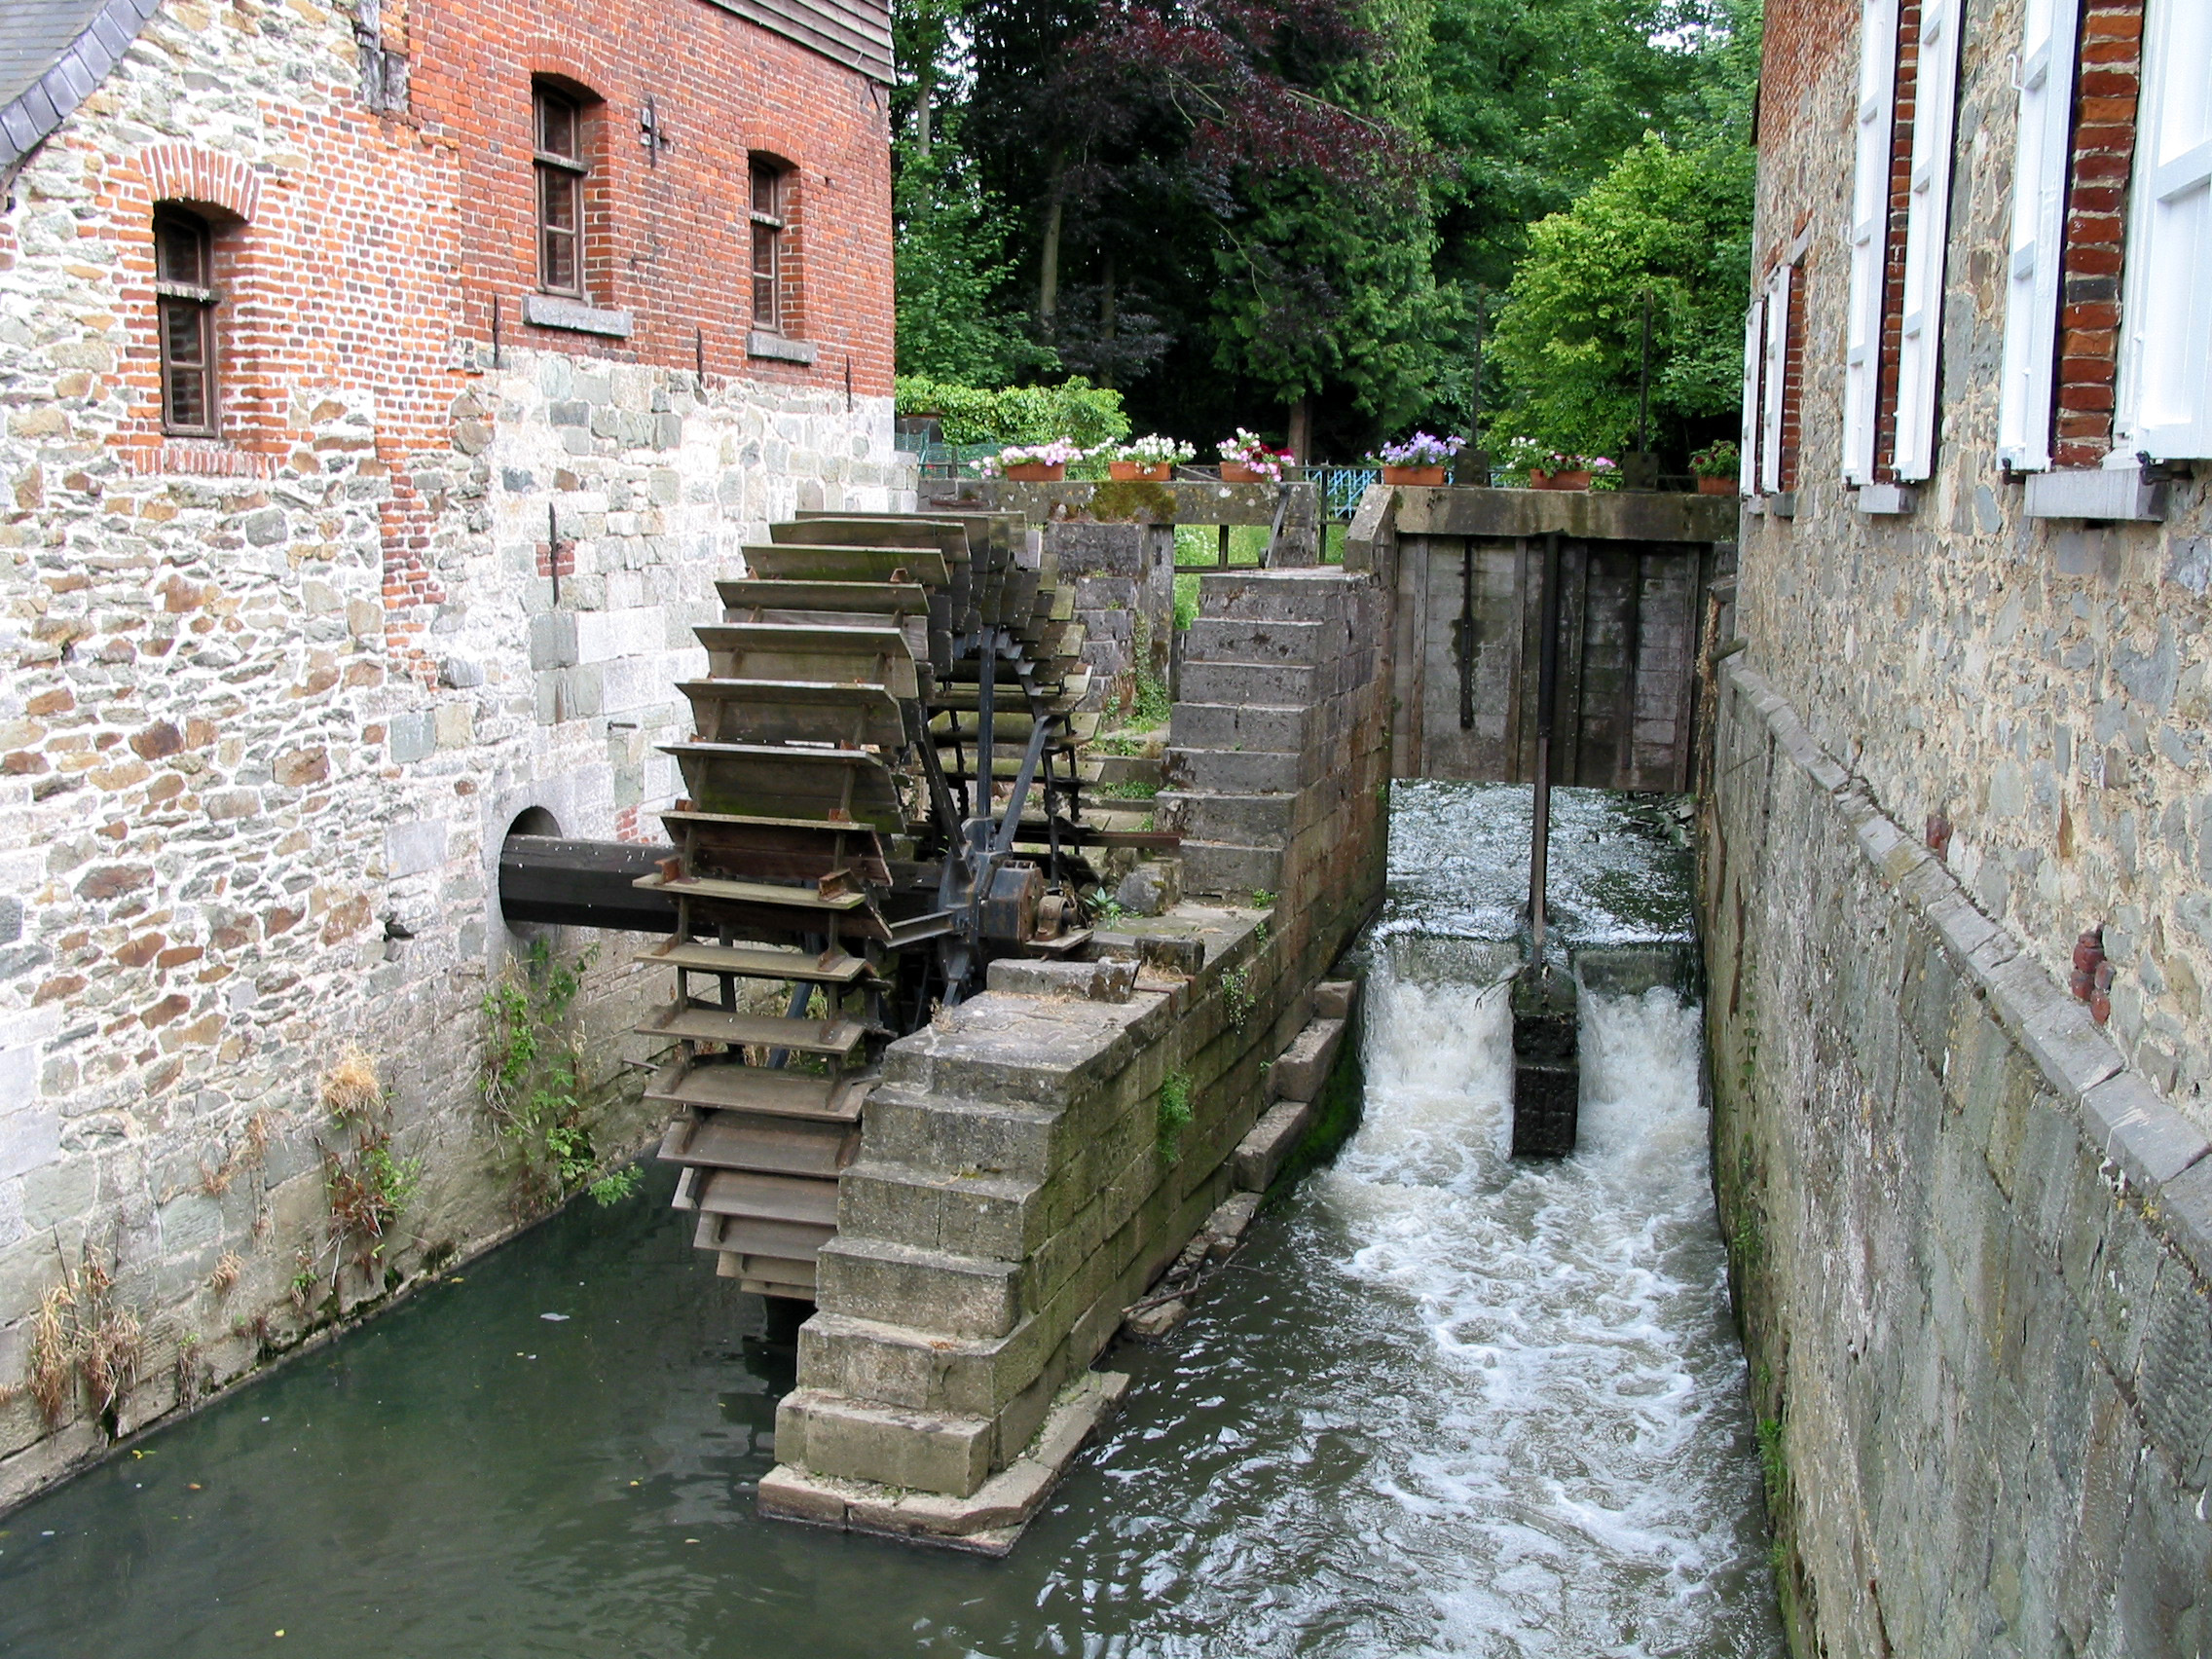
Next time:
Stream Processing Architectures
Source: Wikipedia (River)

Slide 46

Questions?
Source: Wikipedia (Japanese rock garden)

